Slide 1
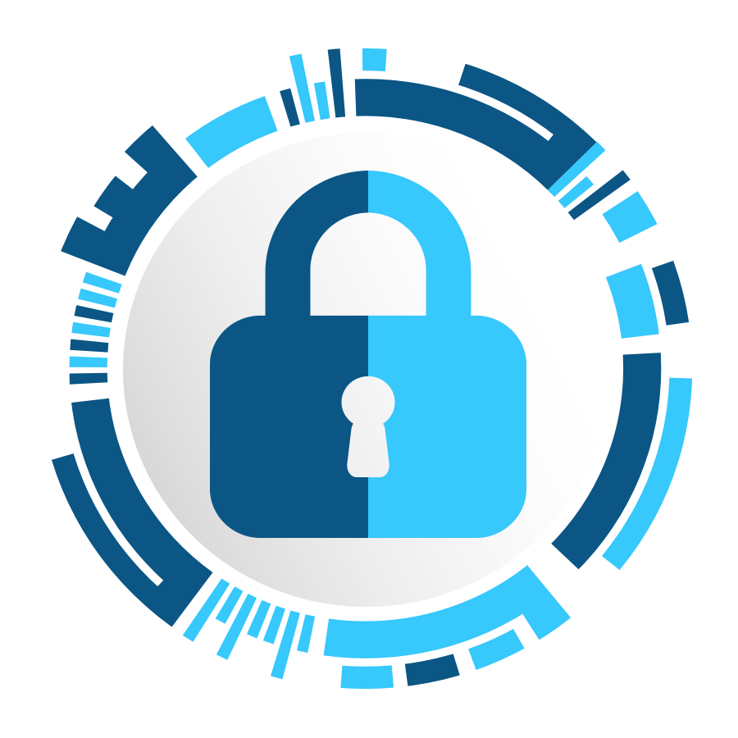
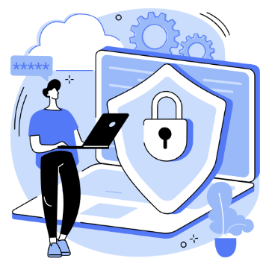
Introduction to
cybersecurity
Workshop
Presented by: Brahim Ferik

Slide 2
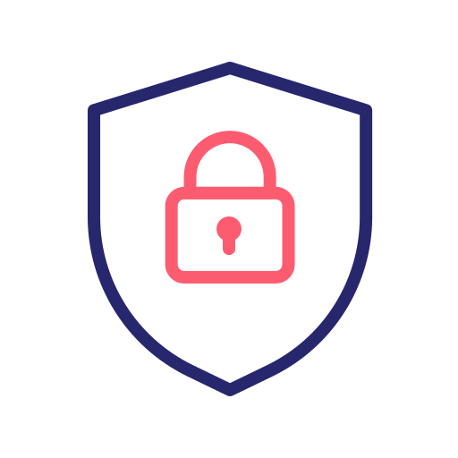
always remember
Nothing is ever completely or truly secure.
Notes:
تقليل المخاطر إلى أدنى حد.

Slide 3
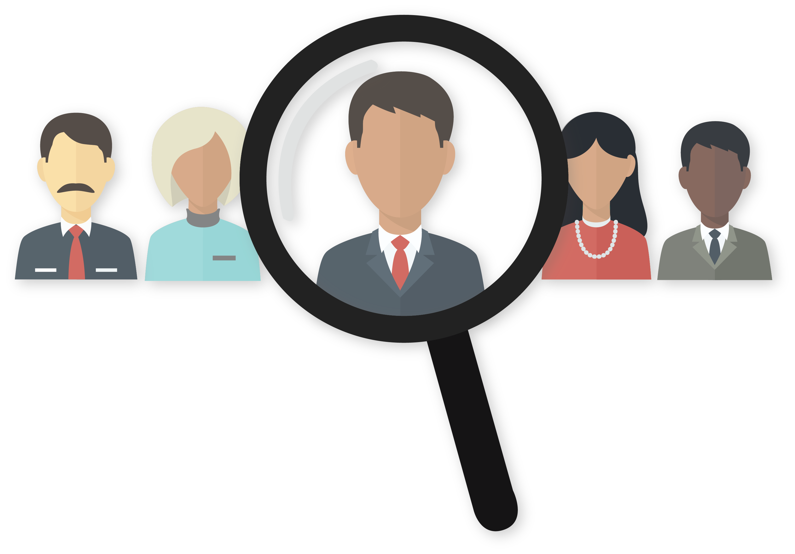
Are You a Target?
Notes:
نعم, الجميع معرضون للاستهداف.

Slide 4
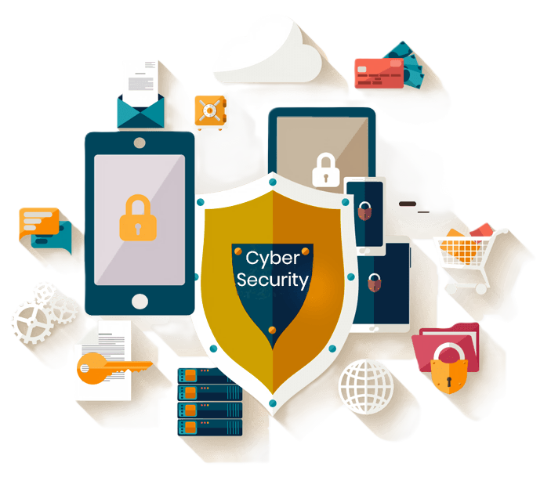
Cyber security

Slide 5
Cyber security
Cybersecurity protects digital systems, networks, and data from attacks, unauthorized access, and damage. It uses various technologies and practices to safeguard information in our connected world. This field aims to prevent, detect, and respond to threats like malware, hacking, and data breaches.
Notes:
يخص الرقمية

Slide 6
CIA of SECURITY SERVICES

Slide 7
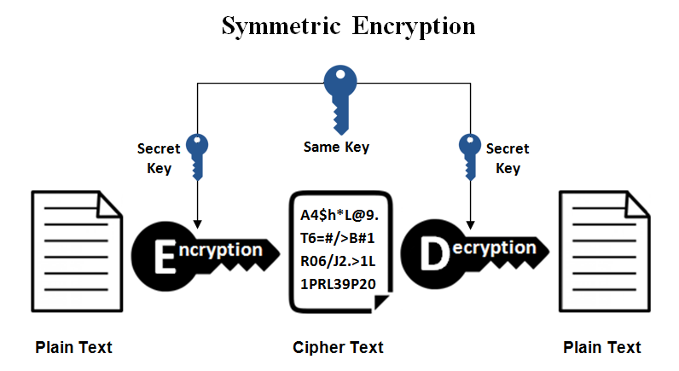
Encryption, Encoding and Hashing

Slide 8
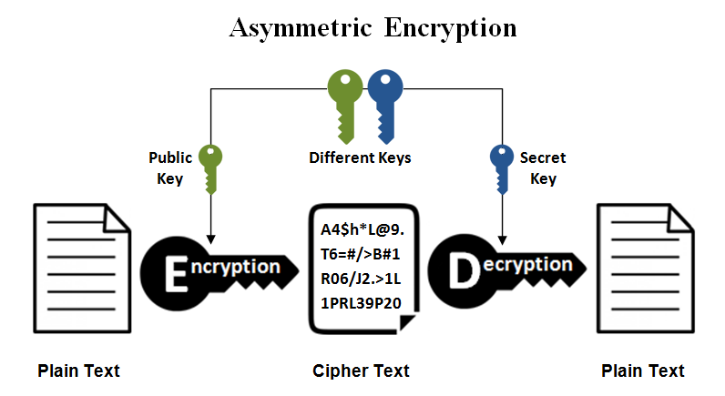
Encryption, Encoding and Hashing

Slide 9
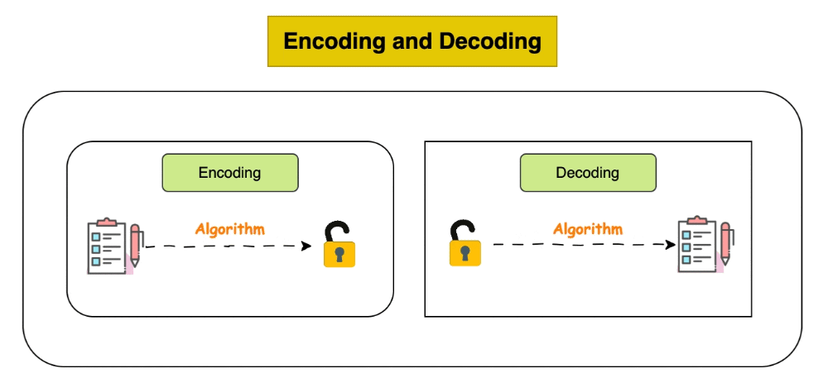
Encryption, Encoding and Hashing

Slide 10
Encryption, Encoding and Hashing

Slide 11
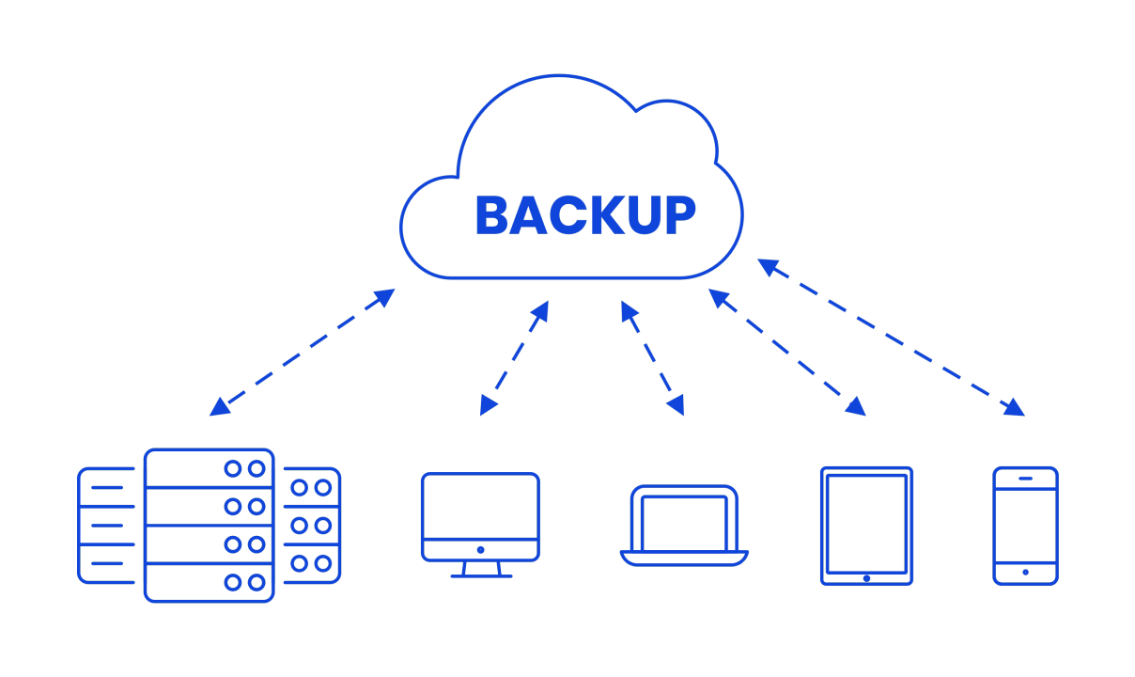
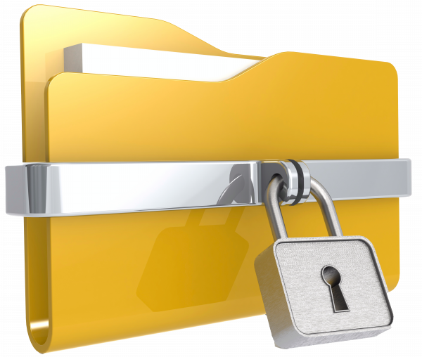
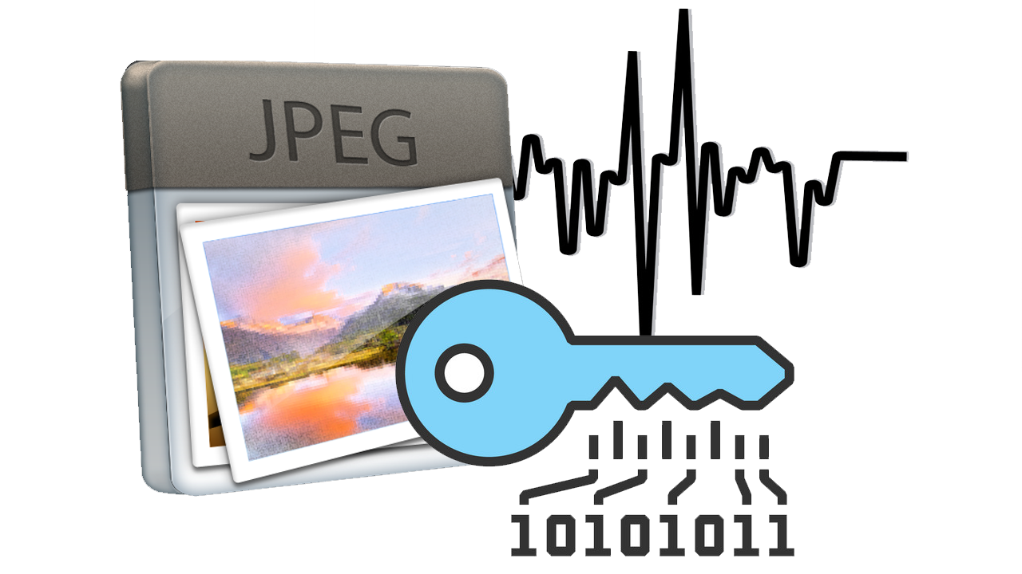
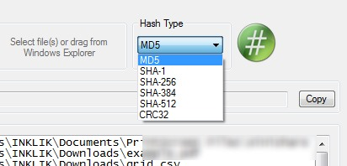
CIA of SECURITY SERVICES Practice
Notes:
- شرح التشفير المتماثل و التشفير غير المتماثل
- تشفير ملف + تشفير محتوى و اسم الملف ايضا
اخفاء البيانات
حساب الهاش
استخدام control version

Slide 12
CIA of SECURITY SERVICES Practice
File Encryption with Password Protection
Verifying File Integrity with Hashes
Backup and Disaster Recovery
Notes:
- شرح التشفير المتماثل و التشفير غير المتماثل
- تشفير ملف + تشفير محتوى و اسم الملف ايضا
اخفاء البيانات
حساب الهاش
استخدام control version

Slide 13
CIA of SECURITY SERVICES Practice
https://shorturl.at/PTB5X
Notes:
- شرح التشفير المتماثل و التشفير غير المتماثل
- تشفير ملف + تشفير محتوى و اسم الملف ايضا
اخفاء البيانات
حساب الهاش
استخدام control version

Slide 14
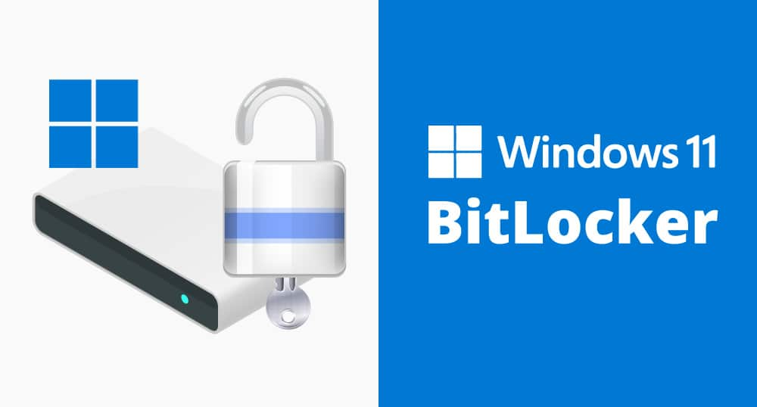
Practical Encryption

Slide 15

Practical Encryption

Slide 16
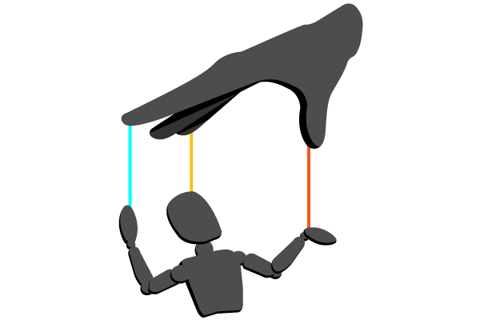
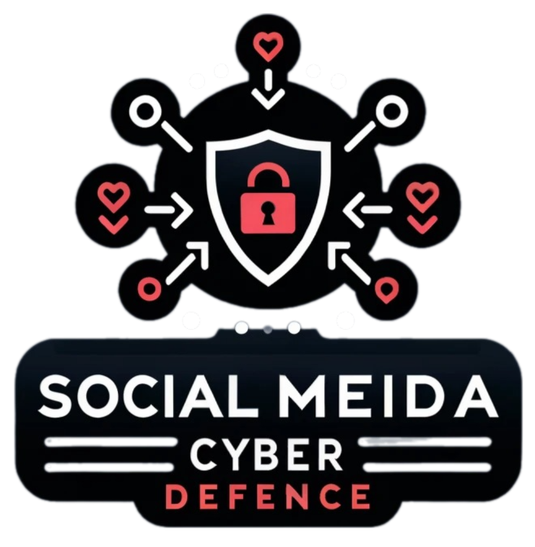
social engineering

Slide 17
social engineering
Social engineering is a deceptive tactic exploiting human psychology to gain unauthorized access or information. Unlike technical hacking, it manipulates people through trust, urgency, or emotion. Attackers may impersonate authorities, create false scenarios, or use persuasion to bypass security.
Notes:
الثغرات النفسية للبشر بدلاً من الثغرات التقنية.

Slide 18
psychological techniques
Trust
Urgency
Baiting
Phishing
Consensus
Fear

Slide 19
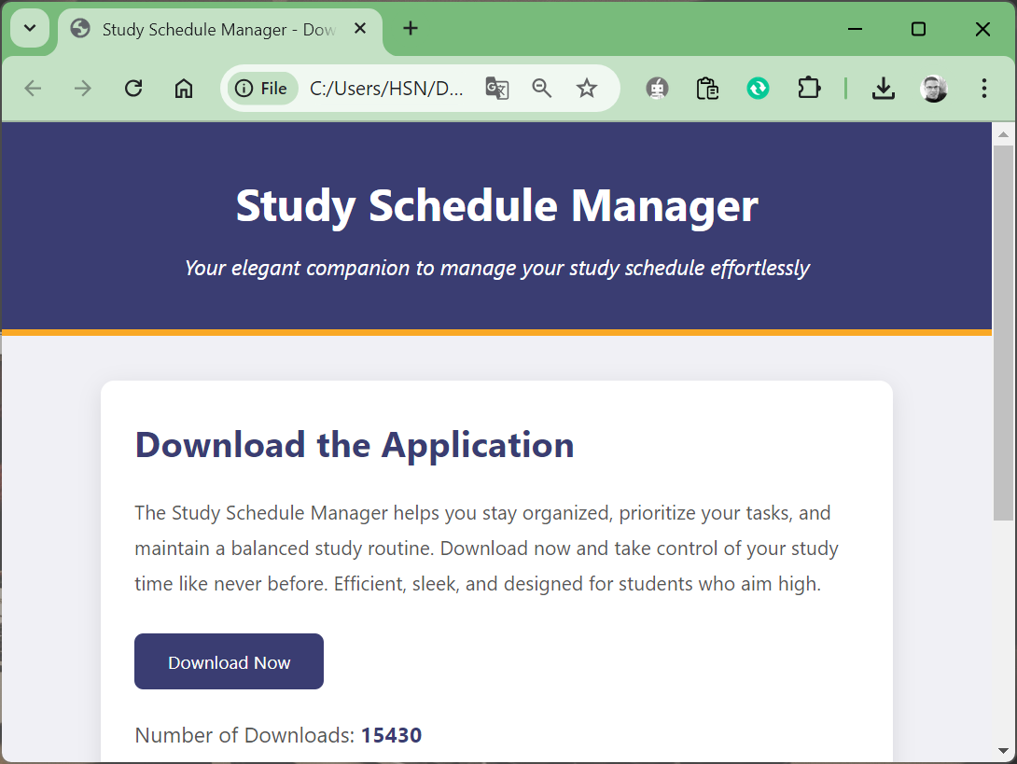
Example of Consensus
154300

Slide 20
The four phases of a social engineering attack
Discovery and investigation
Deception and hook
Attack
Retreat

Slide 21
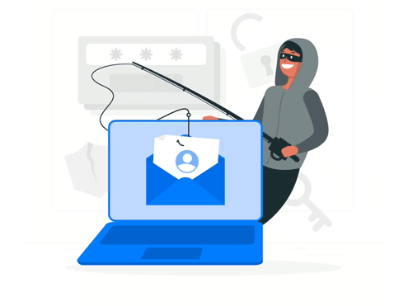
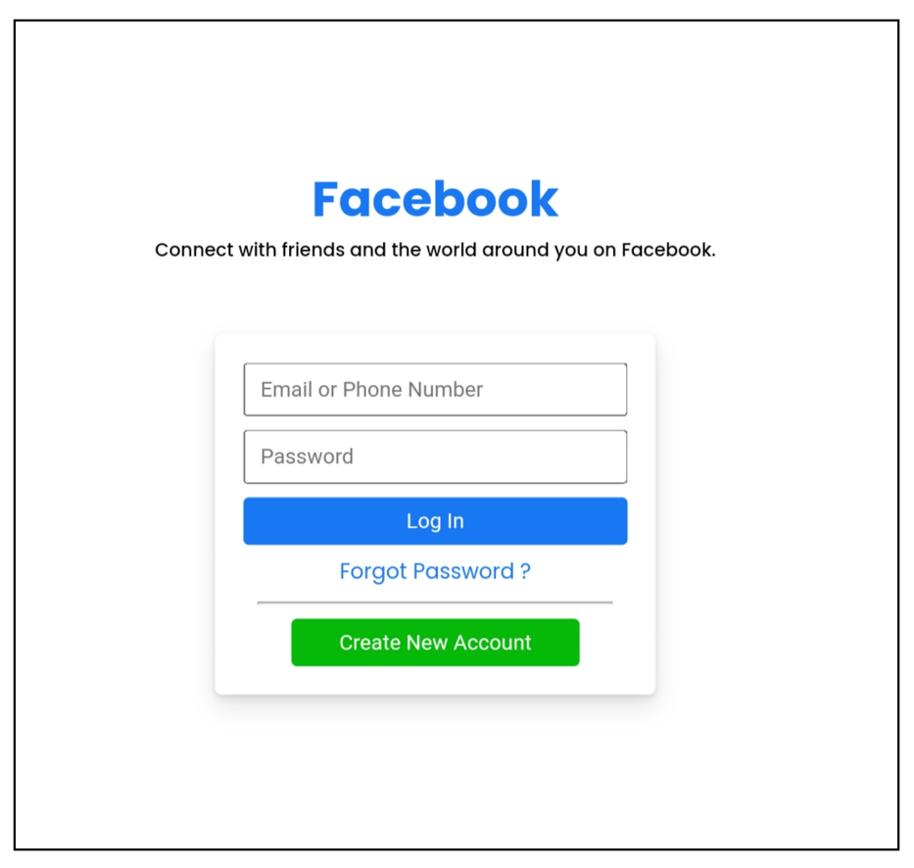
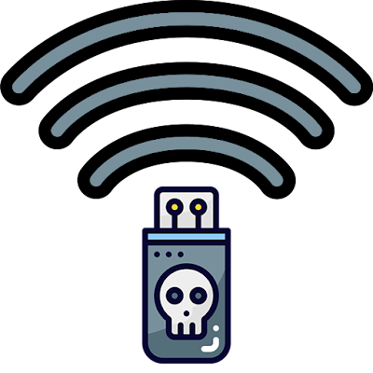
Phishing, Clone Login Pages & Stolen Credentials

Slide 22
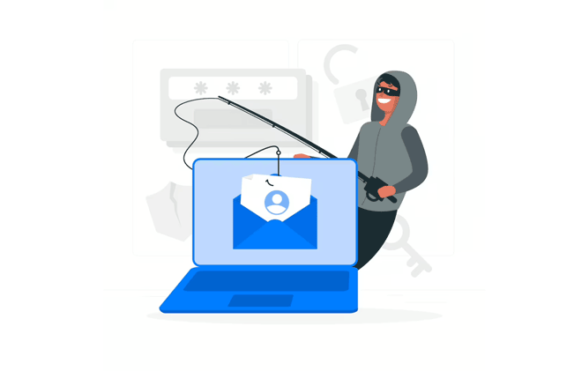
Phishing Email Analysis

Slide 23
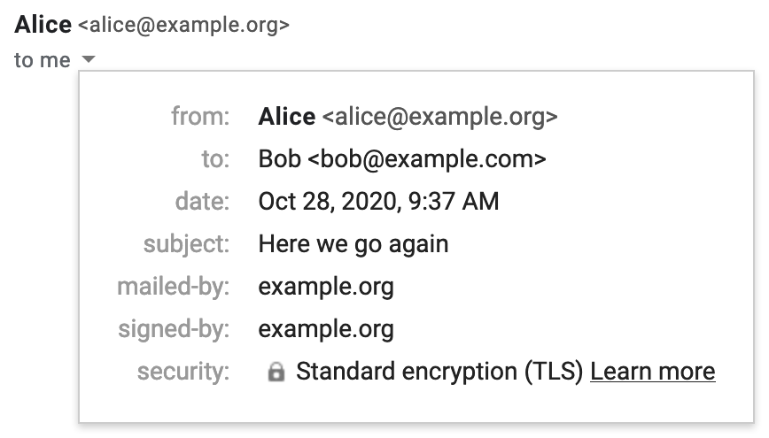
Simple Email Header

Slide 24
Email File Header

Slide 25
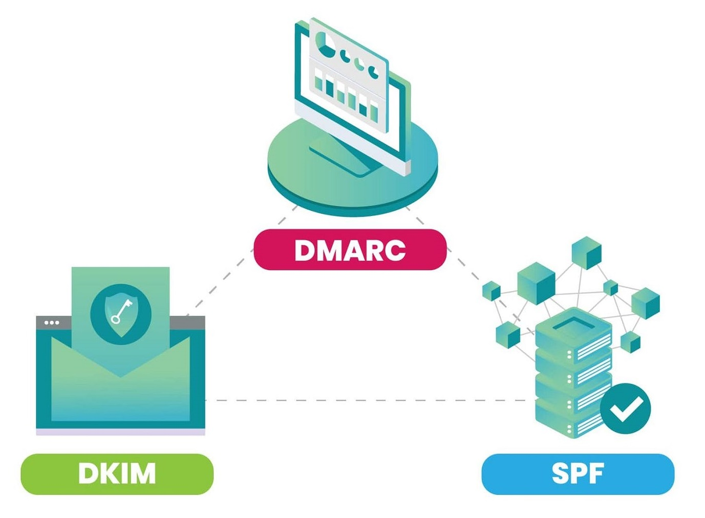
email authentication methods
Domain-based Message Authentication,
Reporting & Conformance
DomainKeys Identified Mail
Sender Policy Framework

Slide 26


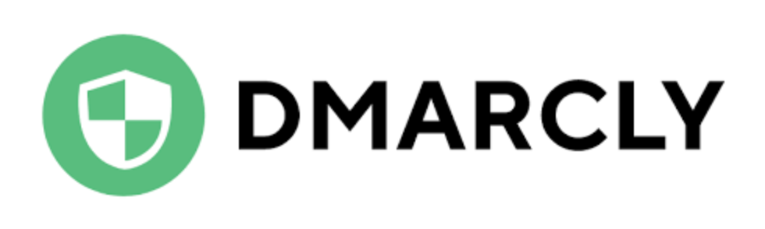
Tools for Email Header analysis

Slide 27
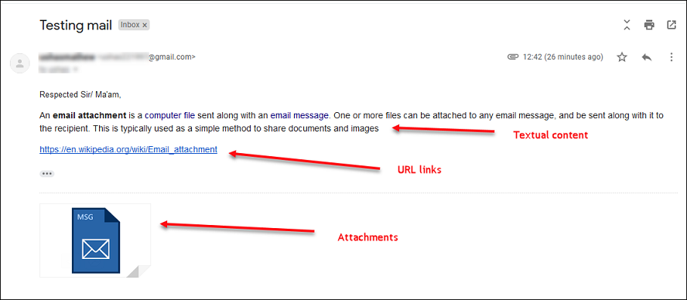
Email Content Analysis

Slide 28
Basic Structure of Email File
Content-Type is application/pdf.
Content-Disposition specifies it's an attachment.
Content-Transfer-Encoding tells us it's base64 encoded.

Slide 29
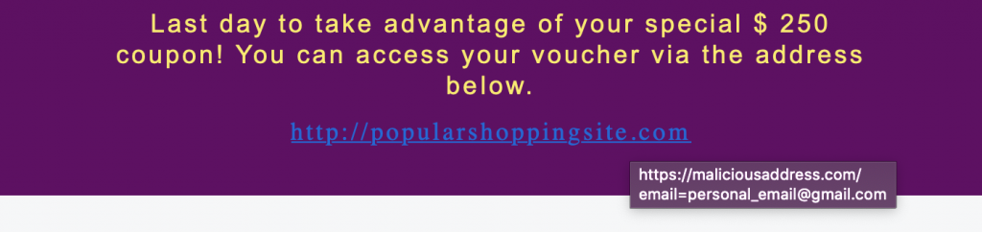
HTML Emails Support

Slide 30
Reading URLs to Avoid Phishing Scams
Incorrectly spelled domain names:
googIe.com
facebo0k.com
amzon.com
appel.com
micorsoft.com

Slide 31
Domain Jumble:

Slide 32
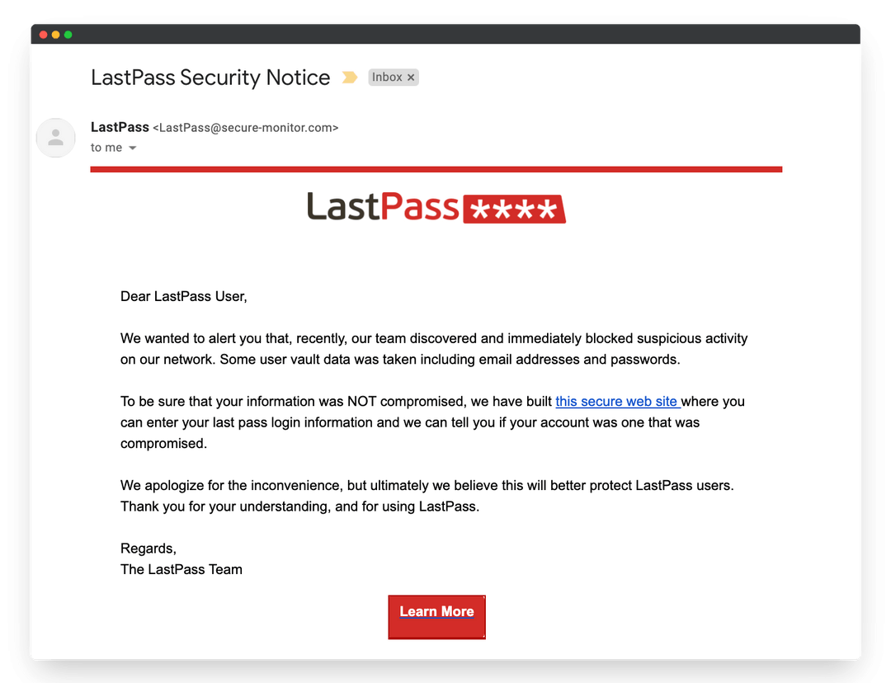
Phishing Email example

Slide 33
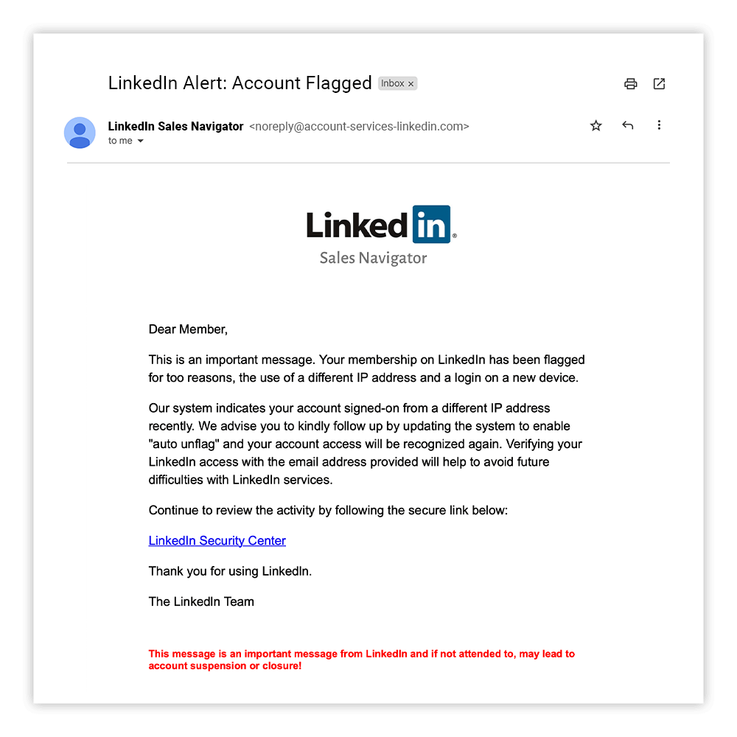
Phishing Email example

Slide 34
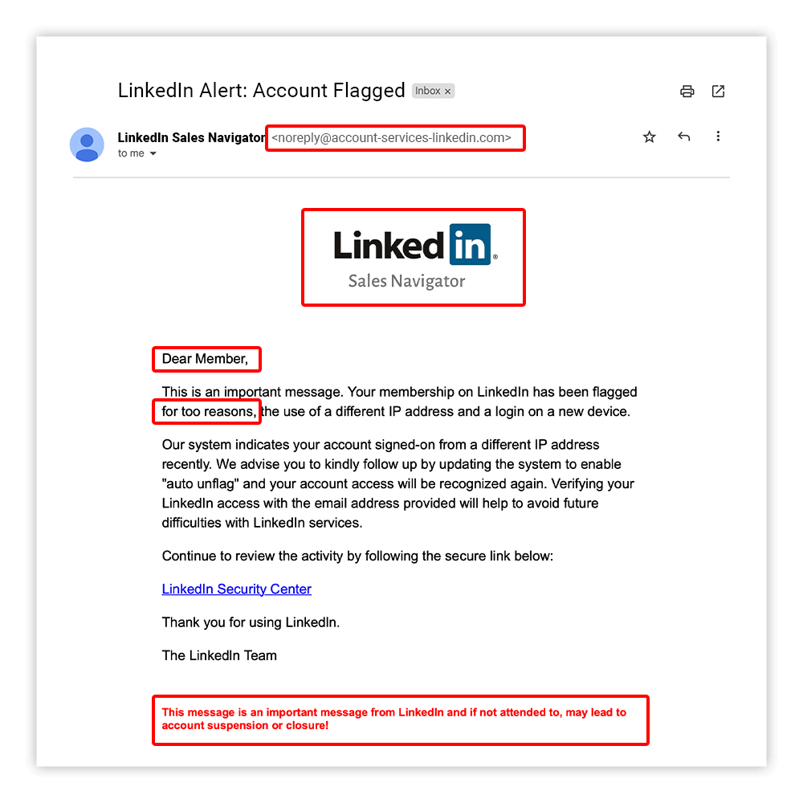
Phishing Email example

Slide 35
Phishing indicators
The sender's email address is not associated with the company.
The email uses a fake company logo.
does not mention any specific details.
The email contains grammatical errors.

Slide 36
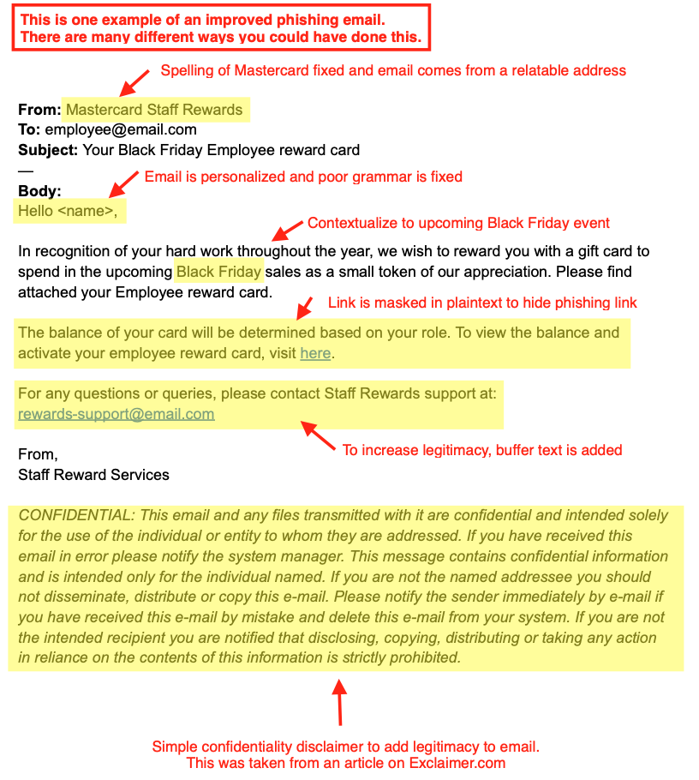
Phishing Email example

Slide 37
Online Phishing Test
https://shorturl.at/Lc16R
https://shorturl.at/YMx8t

Slide 38
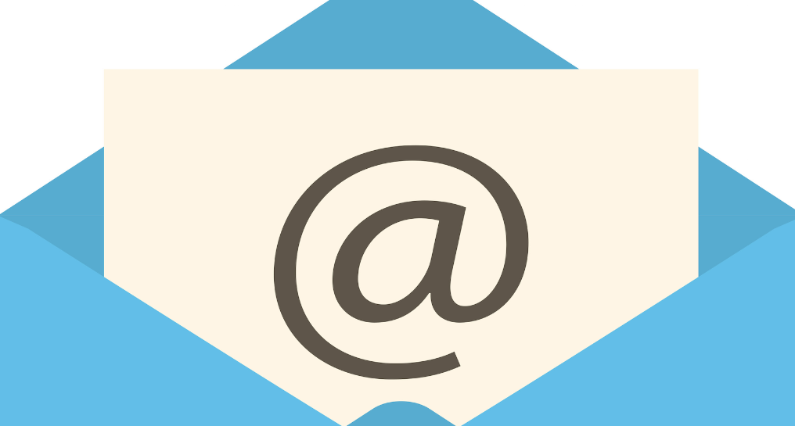
real-life scenario
emkei.cz
temp-mail.org
Fake email generator

Slide 39
https://shorturl.at/JnATO

Slide 40
Phishing Email Analysis
Phishing Email Investigation:
A Practical Exercise

Slide 41

Phishing Email Analysis
phishtool
The power to reverse engineer phishing emails

Slide 42
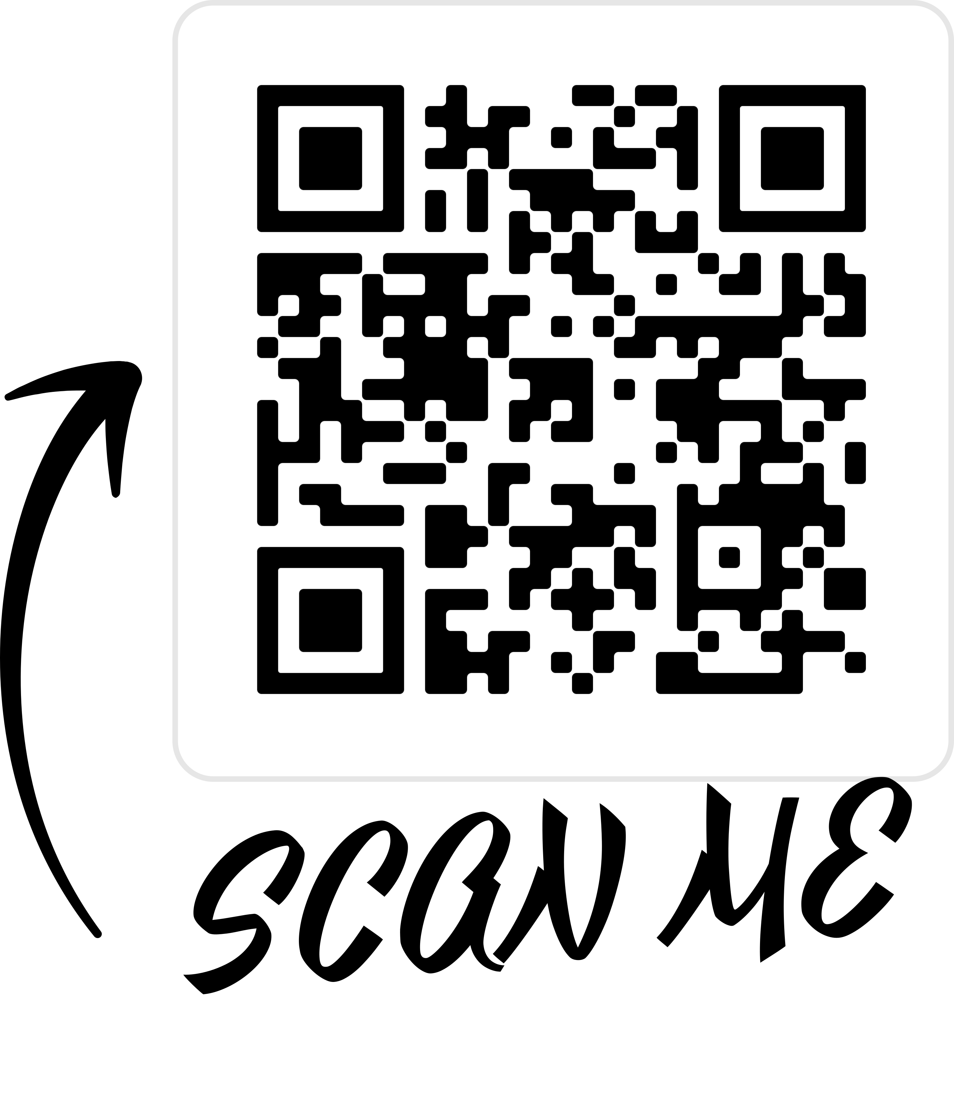
Quishing

Slide 43
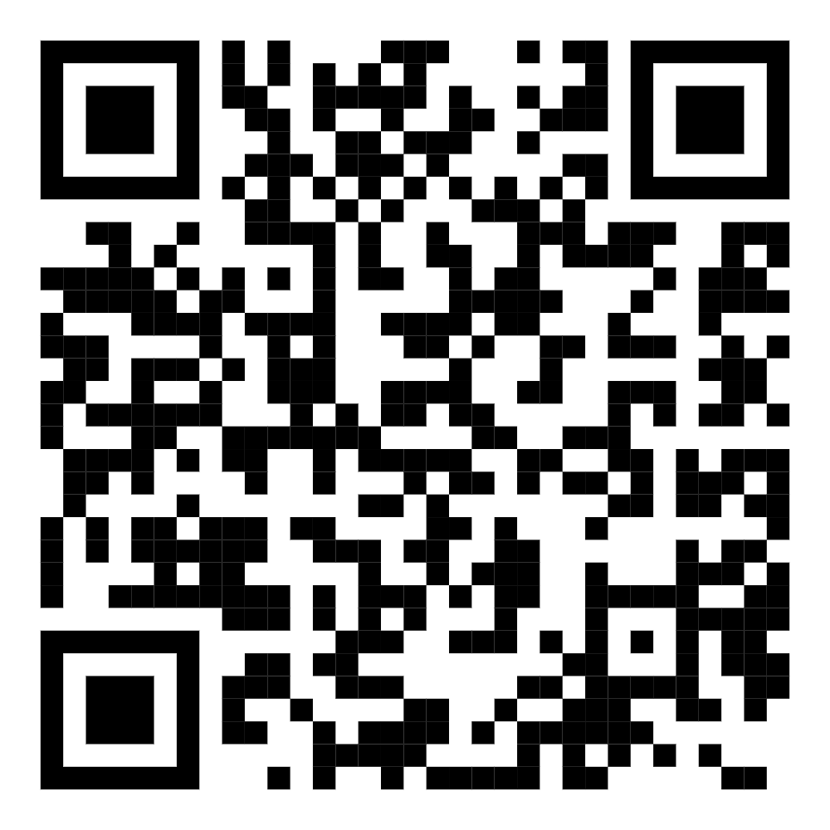

Slide 44
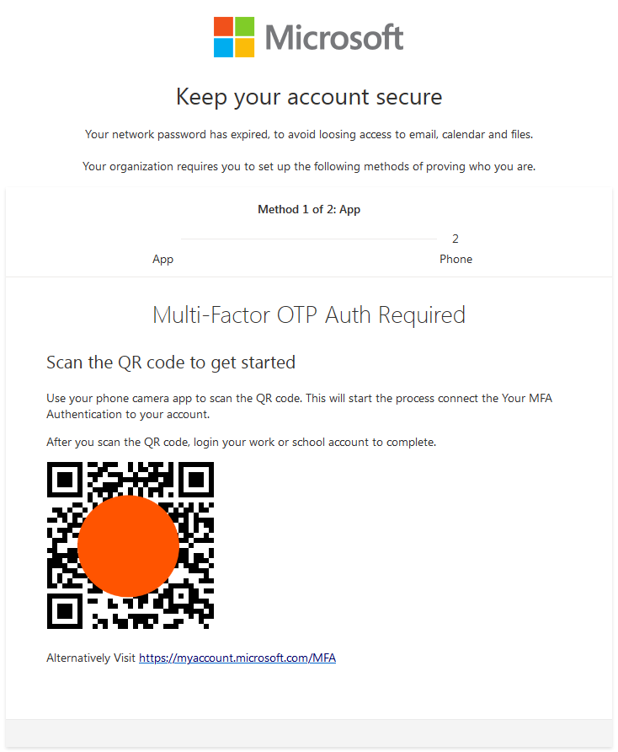
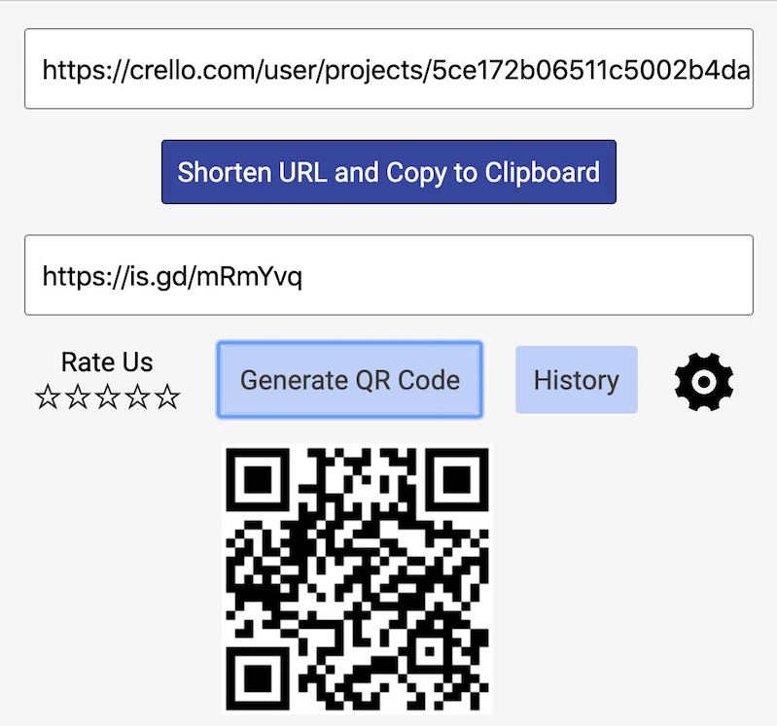
Quishing

Slide 45
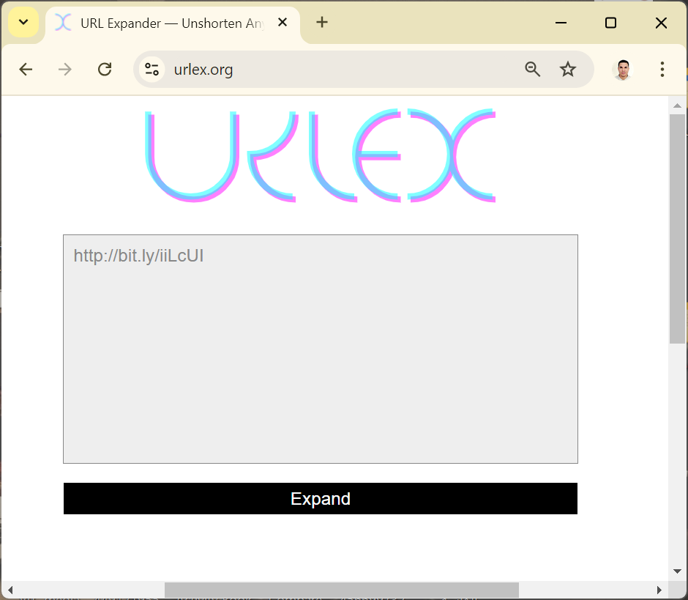
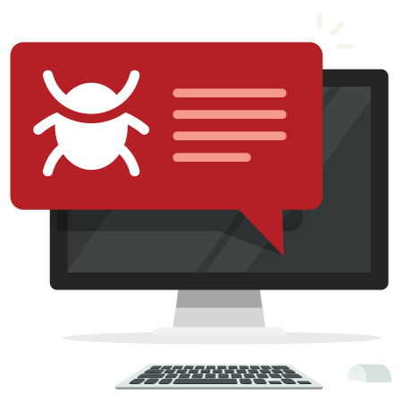

Quishing Simulation Process

Slide 46
Protective Measures
Verify the Source of a QR Code
Preview the Destination URL
Update your device’s security and overall defense system

Slide 47
Stolen Credentials

Slide 48


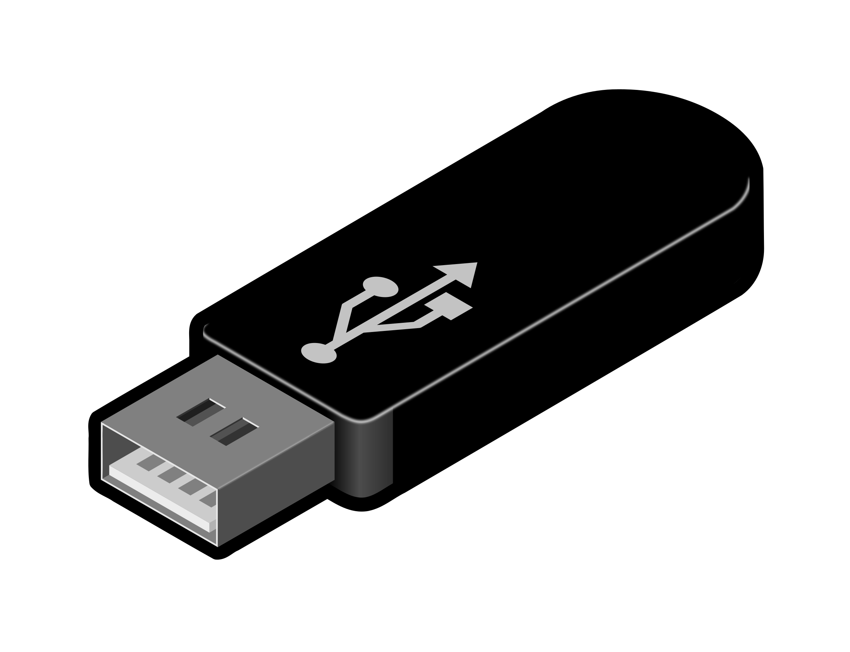

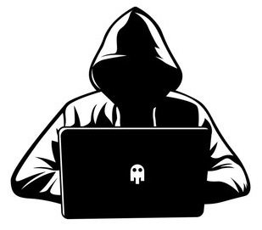
Password stealer attack

Slide 49
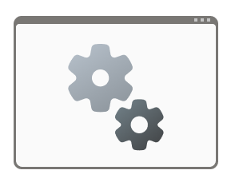

A Practical Exercise
www.nirsoft.net
Batch Script
Vbscript

Slide 50
Protective Measures
Disable Autorun and Autoplay
Use Antivirus Software
Avoid Opening Unknown USB Drives
Regularly Update Windows

Slide 51
Disable Autorun and Autoplay
Win + R , gpedit.msc
Computer Configuration > Administrative Templates > Windows Components > AutoPlay Policies.
Turn off AutoPlay , Enabled

Slide 52
the Top Social Engineering tools
SET (Social-Engineer Toolkit)
GoPhish
HiddenEye
BeEF (Browser Exploitation Framework)
Beelogger
Evilginx

Slide 53
References
https://mailtrap.io/blog/email-headers/
https://app.letsdefend.io/training/lesson_detail/email-header-analysis
https://medium.com/@DaoudaD/basic-analysis-of-a-phishing-email-fbe2276a7d67

Slide 54

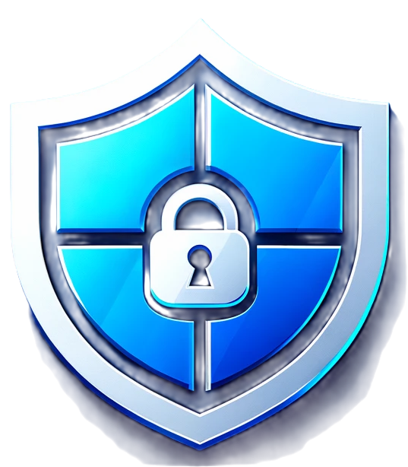
Common Vulnerabilities and Exposures (CVE)

Slide 55
Common Vulnerabilities and Exposures (CVE)
Standardization
Ease of Management

Slide 56
Where to Find CVE Listings
MITRE CVE Database
National Vulnerability Database (NVD)
Security advisories from software vendors

Slide 57
How to Exploit a CVE
Research
Environment Setup
Tools
Execution
Analysis

Slide 58
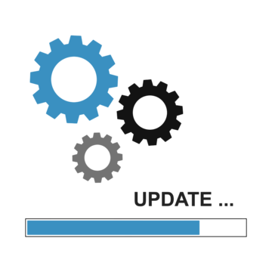
update software

Slide 59
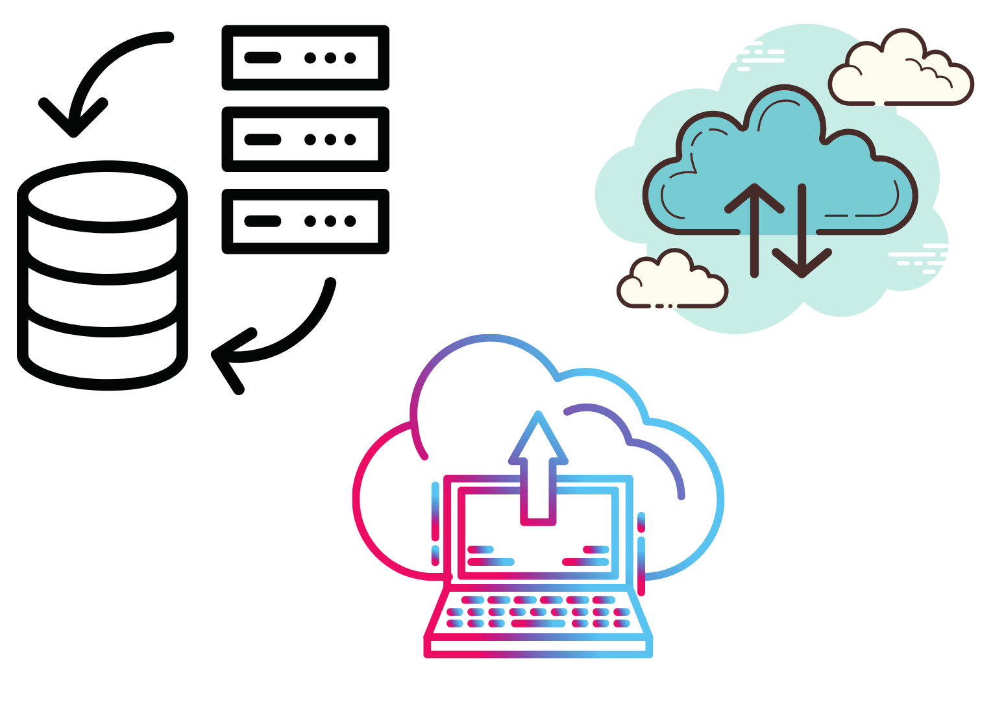
Data Backup Strategies
www.duplicati.com

Slide 60

delete data permanently
eraser.heidi.ie
www.fileshredder.org

Slide 61
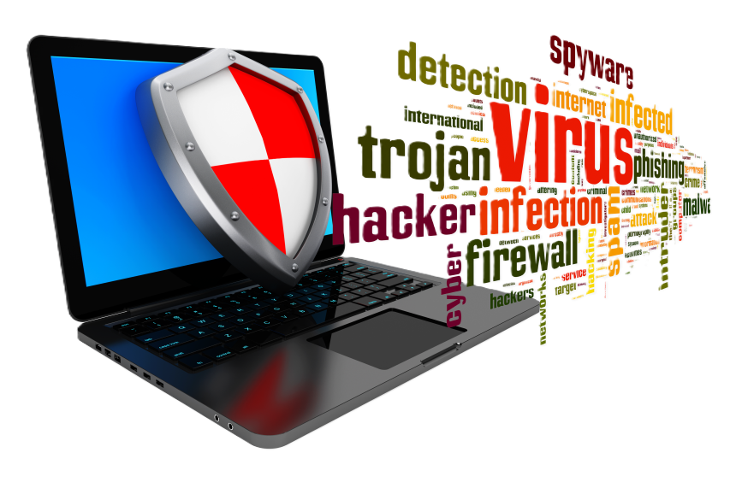
Best practices for malware scanning

Slide 62
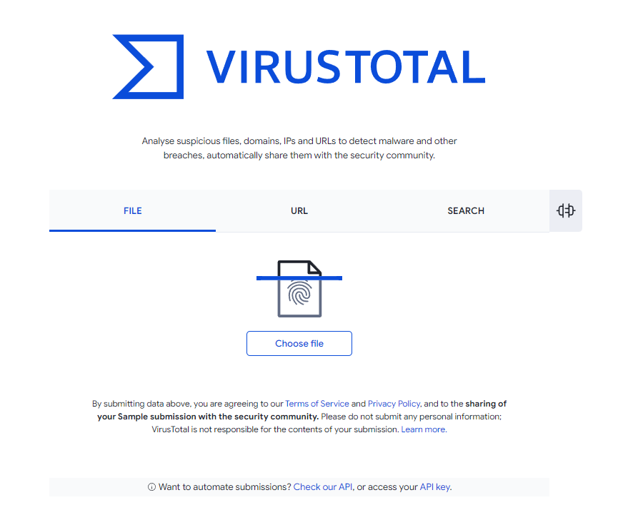
Best practices for malware scanning
virustotal.com
any.run
www.hybrid-analysis.com
virusscan.jotti.org

Slide 63
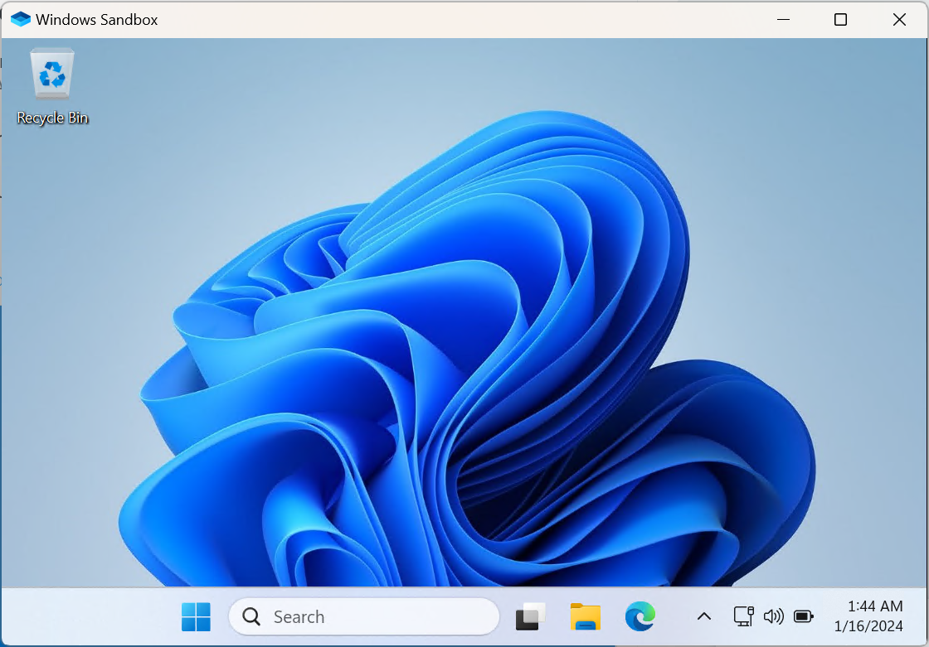
Best practices for malware scanning

Slide 64
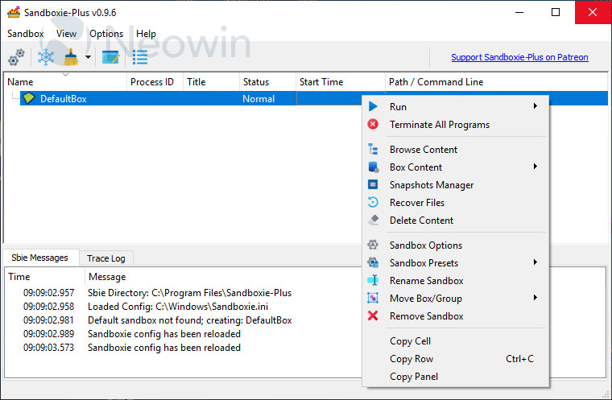
Best practices for malware scanning

Slide 65
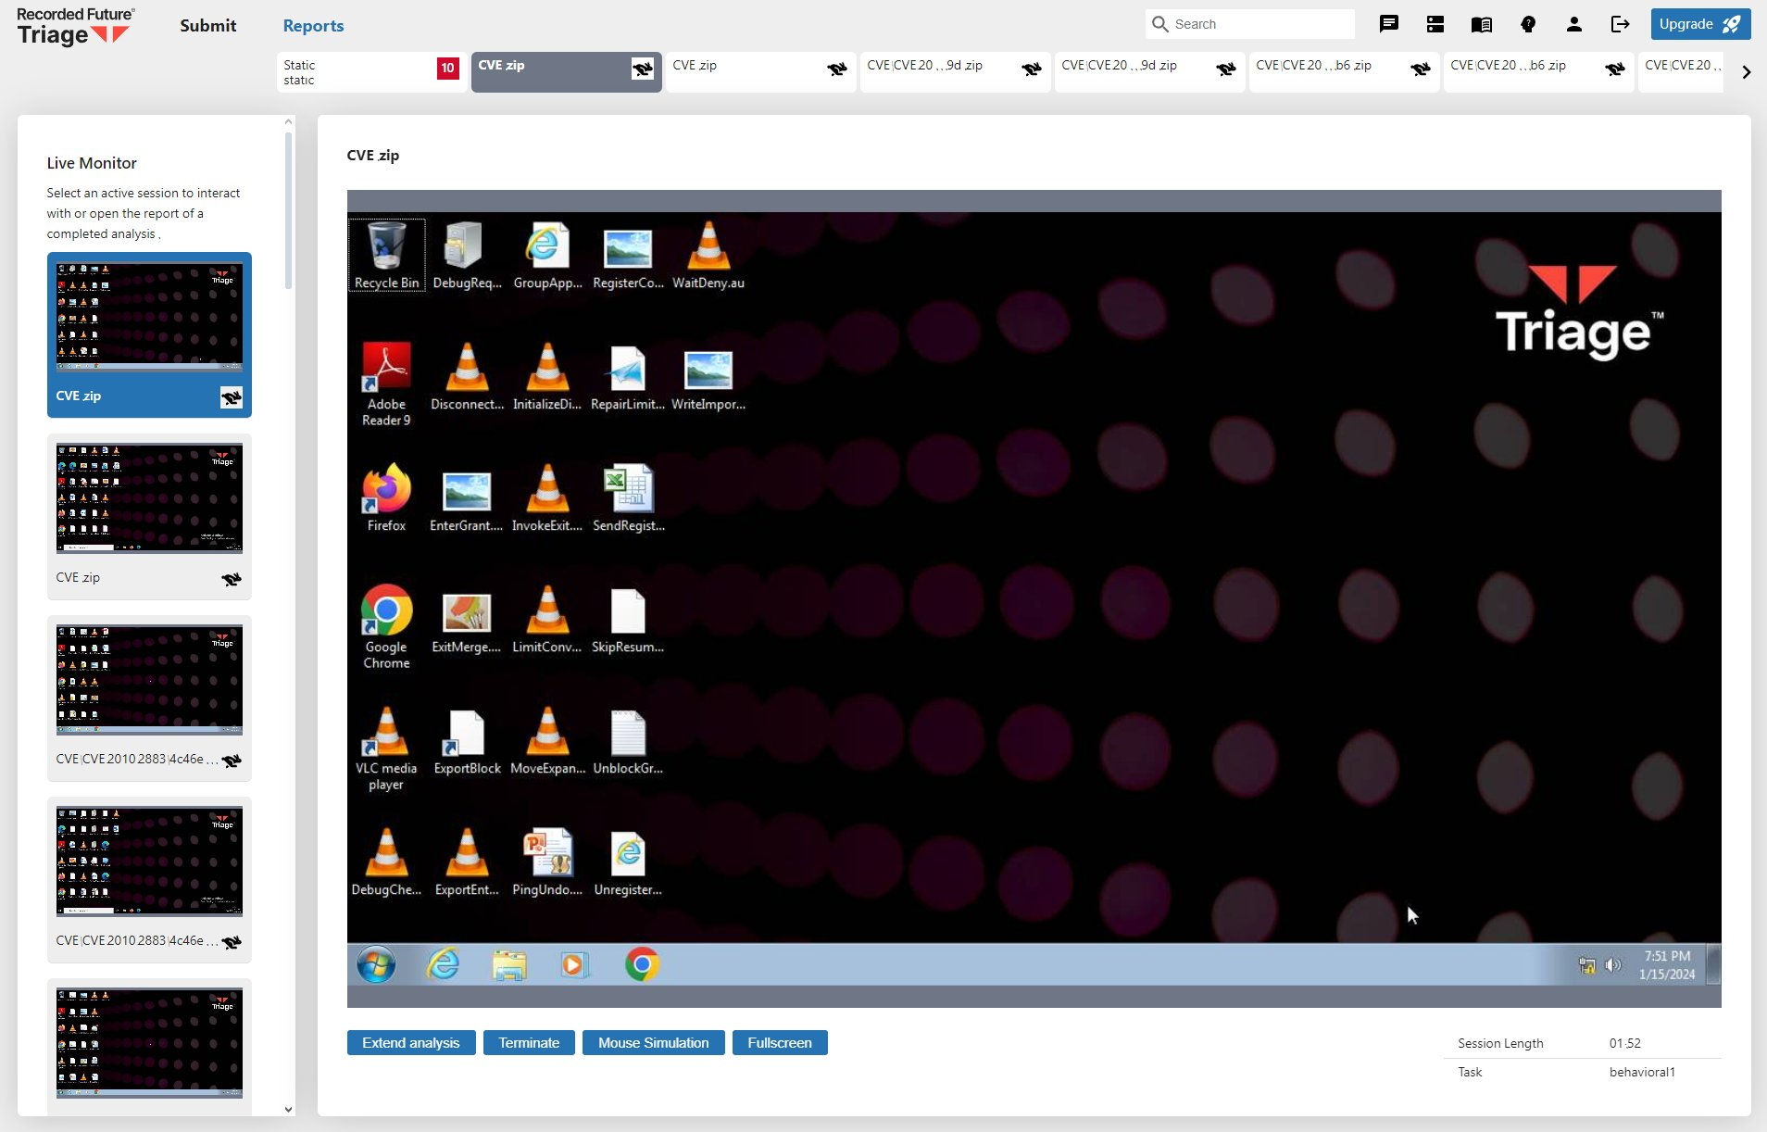
Best practices for malware scanning
Recorded Future Triage
Tria.ge

Slide 66
Best practices for malware scanning
https://shorturl.at/dJC6O

Slide 67
Best practices for malware scanning
https://shorturl.at/60qCk

Slide 68
Best practices for malware scanning
bazaar.abuse.ch
github.com/ytisf/theZoo
github.com/jstrosch/malware-samples

Slide 69
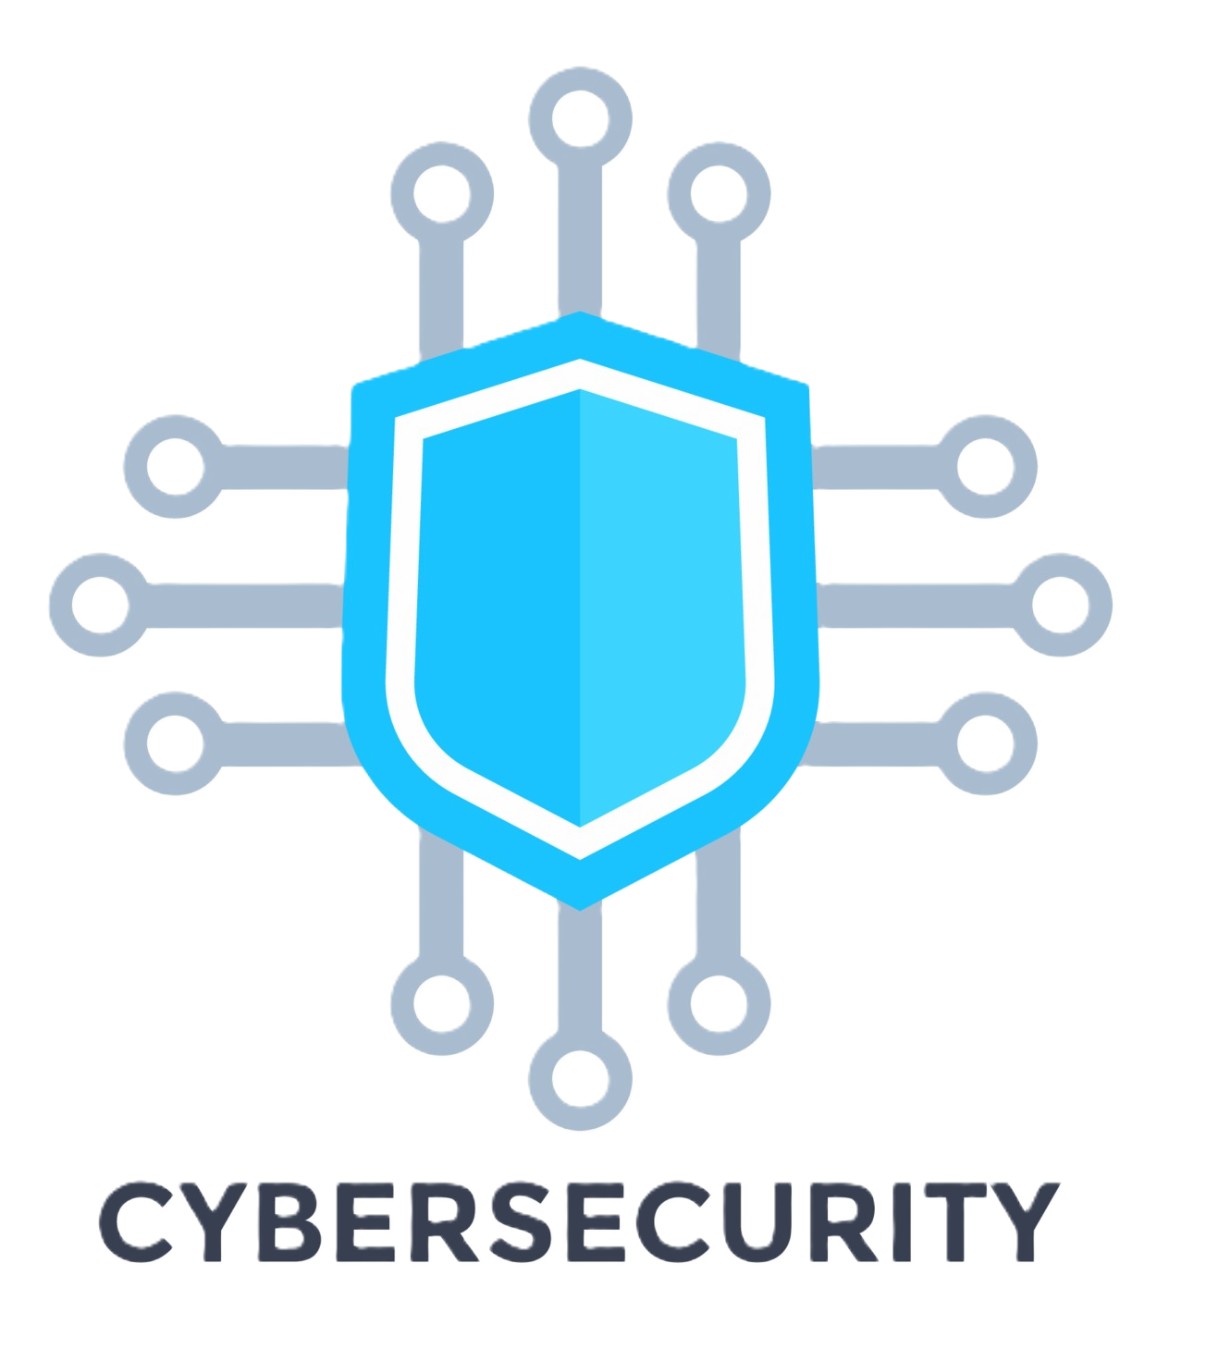

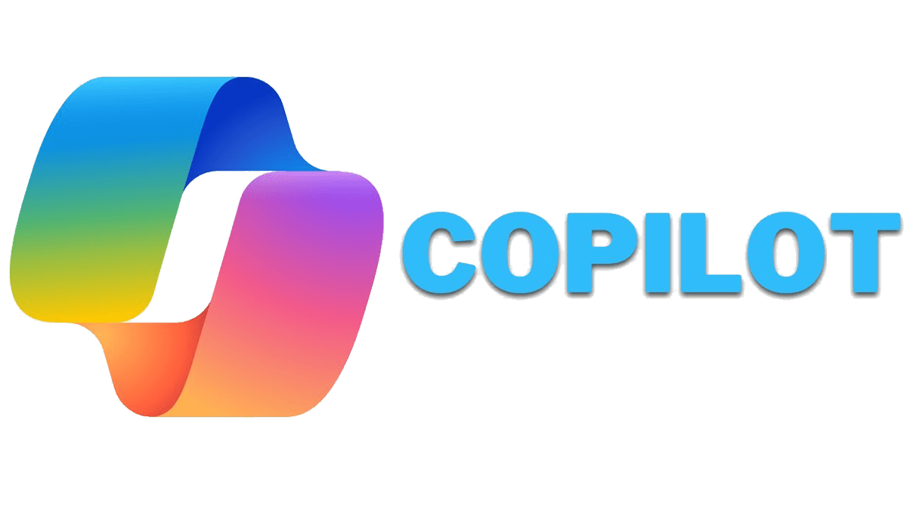
AI for ethical hacking

Slide 70
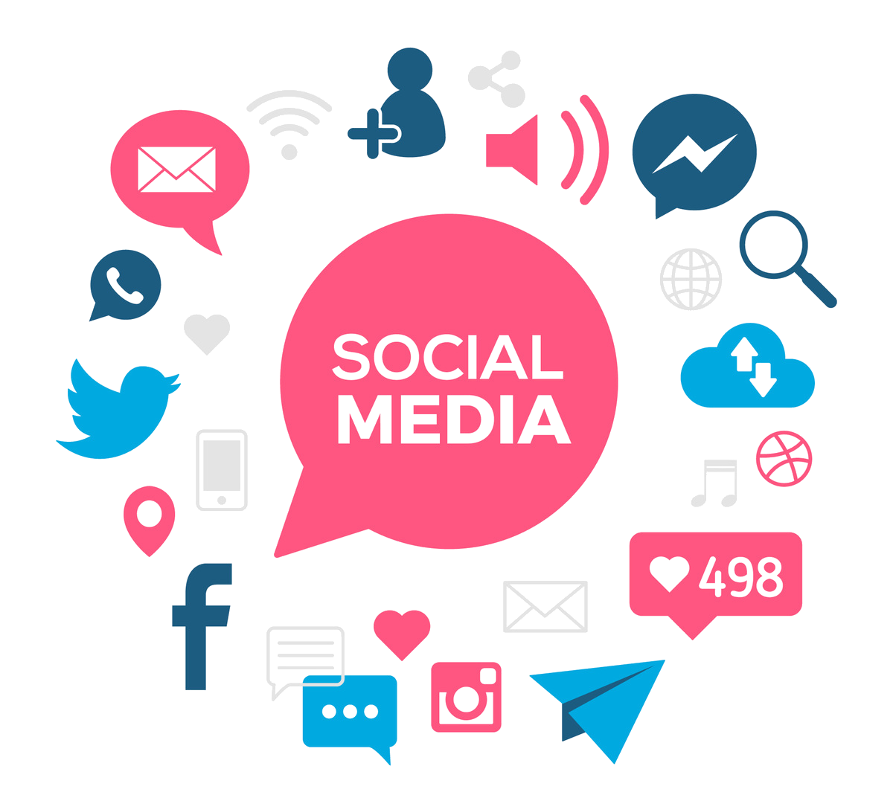
Social media cyber defense

Slide 71

top most common passwords 2023

Slide 72

Verification of protection?
haveibeenpwned.com

Slide 73

Password cracking simulation

Slide 74
How to Prevent Brute Force Password Hacking?
Never use information that can be found online (like names of family members).
Have as many characters as possible.
Combine letters, numbers, and symbols.
Be different for each user account.
Do not use common patterns.

Slide 75
How to Prevent Brute Force Password Hacking?
Lockout policy
Progressive delays
Captcha
Requiring strong passwords
Two-factor authentication

Slide 76

How Secure is my password?
www.passwordmonster.com
howsecureismypassword.net

Slide 77

Enable Two-Factor Authentication (2FA)

Slide 78


Enable Two-Factor Authentication (2FA)
Google Authenticator
Microsoft Authenticator

Slide 79


Use a Password Manager

Slide 80

Securing Wireless Networks

Slide 81
Securing Wireless Networks
Common Attacks and Effective Defense Strategies

Slide 82

Securing Wireless Networks

Slide 83
WiFi Security Techniques
Strong Encryption
Strong Passwords
Hiding SSID (Network Name)
MAC Address Filtering

Slide 84



Penetration lab setup

Slide 85
Main Threats to Wi-Fi Networks
Fake access points (Rogue APs)
Weak or no encryption
Brute-force attacks to crack passwords
Attacks targeting connected devices

Slide 86

Main Threats to Wi-Fi Networks

Slide 87

Password Dictionary

Slide 88

Creating a Password Dictionary

Slide 89
Protect WiFi from Deauthentication (Deauth) Attacks
Enable Protected Management Frames (PMF)
Disable Broadcast of SSID (Hiding SSID)
Strengthen Access Controls
Deploy a Wireless Intrusion Detection/Prevention System (WIDS/WIPS)

Slide 90
Evil Twin Attack

Slide 91
Secure Your Wi-Fi Network
Use strong encryption protocols
Change the default network name (SSID) and password
Regularly update your router’s firmware
Enable firewalls
Disable Control Panel settings if feasible

Slide 92


Ensure Your Wi-Fi is Private and Blocking Hackers

Slide 93
Securing Wireless Networks
Next Lesson

